Slide 1
Distributed Systems:
Operating System Support
Chapter 6:
Introduction
The operating system layer
Processes and threads
Communication and invocation
operating system architecture

Slide 2
Network OS?
Traditional OS's (e.g. early Unix, Windows 3.0)
  simplify, protect and optimize the use of local resources
Network OS's (e.g. Mach, modern UNIX, Windows NT)
  do the same but they also support a wide range of communication standards and enable remote processes to access
  E.g., Remote File Access, Remote Login
  The nodes running network OS retain autonomy in managing their own processing resources.
  Multiple system images one per node.

Slide 3
What is Distributed OS?
  Presents users (and applications) with an integrated computing platform that hides the individual computers.
  Has control over all of the nodes (computers) in the network and allocates their resources to tasks without user involvement.
    In a distributed OS, the user doesn't know (or care) where his programs are running.
  Single system image.
  Examples: Cluster computer systems, V system, Sprite, Globe OS

Slide 4
Why we are not adopting Distributed OS?
Users have invested much money and time in their application software, which are meeting their requirements. Normal Users will not adopt new OS that will not run their applications whatever efficiency advantage it offers.
Users prefer to have certain degree of autonomy for their machines.

Slide 5
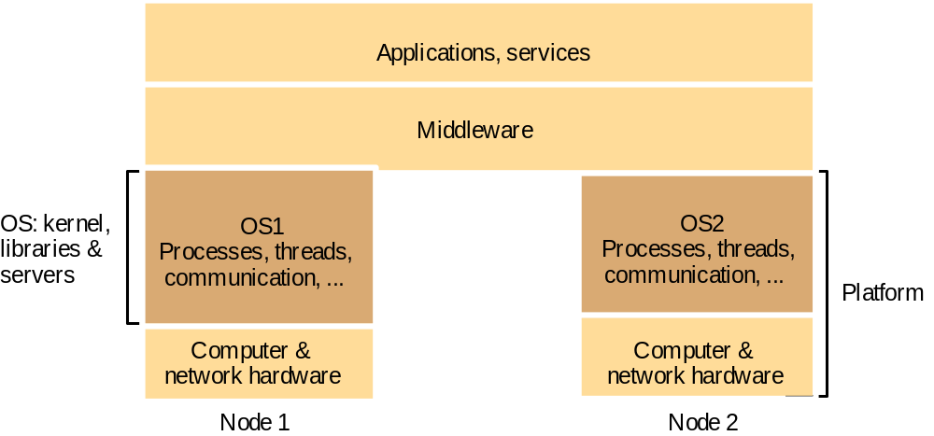
System layers
Figure 6.1
*

Slide 6
System Layers
OS running at a node provides its own flavor of abstraction of local resources for processing, storage and communication.
Middleware utilizes a combination of these resources to implement its mechanisms for remote invocations between objects and processes at nodes.
Users will be satisfied if their middleware-OS Combination has good performance.
OS layer may be different on every machine however the middleware and applications remain same.

Slide 7
Operating System Layer
OS manages the basic resources of computer systems:
  processing, memory, persistent storage and communication.
Kernel and the server processes are the components on the server side which are responsible to manage and provide an opportunity to the clients to access them
*

Slide 8
Operating System Layer
It is the task of an operating system to:
  raise the programming interface for these resources to a more useful level:
    By providing abstractions of the basic resources such as: processes, unlimited virtual memory, files, communication channels
    Protection of the resources used by applications
    Concurrent processing to enable applications to complete their work with minimum interference from other applications
  provide the resources needed for (distributed) services and applications to complete their task:
    Communication - network access provided
    Multiprocessing

Slide 9
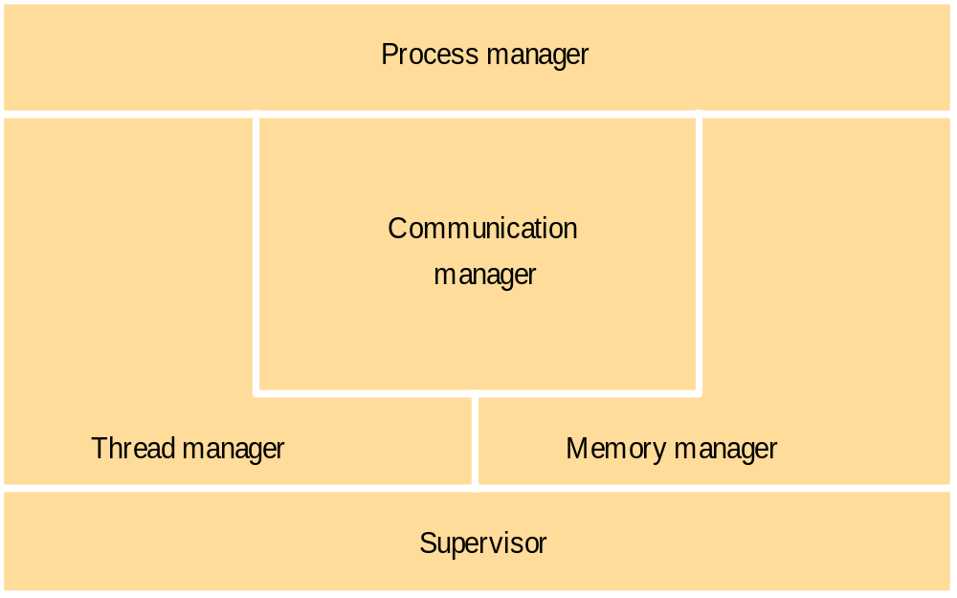
OS Core Functionality
Kernel provides much of this functionality.

Slide 10
OS Core Functionality
Process Manager
  Handles the creation of and operations between processes. Process has its own address space and one or more threads.
Thread Manager
  Thread creation, synchronization and scheduling.
Communication Manager
  Communication between threads attached to different processes on same computer. If kernels don’t support communication between threads on remote computers. We normally require different mechanism (middleware) such as RMI.

Slide 11
OS Core Functionality
Memory Manager
  Management of Physical and virtual memory.
Supervisor
  Termed as Hardware Abstraction Layer in Windows OS
  Dispatching of interrupts and other exceptions, processor register manipulations.

Slide 12
Protection
Resources can be secured if the kernel on that system is also protected.
  If kernel is secure then processes on that system can be secured.
  Illegitimate access will not be allowed thus protecting the resources on your system.
Illegitimate access should not be allowed to the resources managed.

Slide 13
Processes and Threads
A process consists of an execution environment together with one or more threads.
The execution environment is the unit of resource management.
Thread is the operating system abstraction for a unit of activity.
Execution environment basically consists of:
  An address space
  Thread synchronization and comm resources (semaphores, sockets etc)
  High level resources such as open files and windows etc
Threads and processes differ from one operating system to another but, in general, a thread is contained inside a process and different threads in the same process share some resources while different processes do not.

Slide 14
Address Space
Every process has its own address space. An address space is the area were the process lies in the virtual memory.
The address space consists of one or more regions, separated by inaccessible areas of virtual memory. A region is an area of continuous virtual memory addresses.
Moreover a flow of control mechanism is provided to know which part of the program the processor is running at any instant.
In other words, a process is a place to work and a way to keep track of what a program is doing. When several programs are running at the same time, each has its own address space and flow of control.

Slide 15
Process address space
2
N
Two processes may access the shared memory (regions) but not each others memory.
Thread shares the same address space and most data with all other threads running in the same process but have separate flow control.
Regions can be shared among processes
  kernel code
  libraries
  shared data & communication
Auxiliary
regions
Stack
Heap
Text
0
*

Slide 16
Process Creation
In a Distributed System the process creation has two issues:
  Choice of Target Host
  Creation of Execution Environment
Choice of Target Host
  The choice at which host (node) the process will be created is policy issue and depends on the OS criteria
  Transfer Policy: Whether to create a process locally or to transfer it remotely on some other system is determined by transfer policy e.g., load of the system.

Slide 17
Process Creation - Choice of Target Host
Location Policy: Which particular node should be selected for the creation of process. Depends on load on the nodes, resources possessed by nodes and machine architecture.
Process location policies can be:
  Static / deterministic
  Adaptive / heuristic
Location policy based on load sharing systems may be centralized (one load manager), hierarchical or decentralized.

Slide 18
Process Creation - Creation of new Execution Environment
Two approaches:
Firstly, statically assigning address space e.g., program text region, heap and stack; initially empty values are all filled with zeros as appropriate.
Secondly, address space can be defined w.r.t existing execution environment. E.g., new created child process can share the parents text regions and has heap and stack as copies of the parent.
Sufficient time and resources can be saved when an inherited region is copied from the parent using the copy-on-write optimization.

Slide 19
Copy-on-write – a convenient optimization
Process A’s address space
Process B’s address space
RB copied
from RA
RA
RB
Kernel
Shared
frame
A's page
B's page
table
table
a) Before write
b) After write

Slide 20
Threads concept and implementation
What represents the activation of a thread?
Process
Thread activations
Activation stacks
(parameters, local variables)
Heap (dynamic storage,
objects, global variables)
'text' (program code)
system-provided resources
(sockets, windows, open files)
*
Notes:
Question: what represents the activation of each thread?
Answer: Essentially: the current instruction pointer and other registers and a pointer to its activation stack.

Slide 21
Threads and Execution Time
Let us assume that a request at the server takes 2 millisecond for processing and 8 millisecond for I/O to fetch user request from disk.
In a single threaded server it will take 2+8 = 10ms to server a single request i.e., a throughput of 100 requests per second.
If two threads are used then 1000/8 = 125 req/sec
Further assume, a disk block caching is introduced with a hit ratio of 75%.
0.75 x 0 + 0.25 x 8 = 2ms i.e., 500 req/sec

Slide 22
Client and server with threads
Figure 6.5
Thread 2 makes
Receipt &
Input-output
requests to server
queuing
Thread 1
generates
results
Requests
N threads
Client
Server
The 'worker pool' architecture
*

Slide 23
Alternative server threading architectures
server
process
server
process
server
process
workers
per-connection threads
per-object threads
I/O
remote
remote
I/O
remote
objects
objects
objects
a. Thread-per-request
b. Thread-per-connection
c. Thread-per-object
  Implemented by the server-side e.g., ORB in CORBA
  would be useful for UDP-based service, e.g. NTP
  is the most commonly used - matches the TCP connection model
  is used where the service is encapsulated as an object. E.g. could have multiple shared whiteboards with one thread each. Each object has only one thread, avoiding the need for thread synchronization within objects.
*

Slide 24


Slide 25
Java thread synchronization calls
Figure 6.9
See Figure 12.17 for an example of the use of object.wait() and object.notifyall() in a transaction implementation with locks.
thread.join(int millisecs)
  Blocks the calling thread for up to the specified time until thread has terminated.
thread.interrupt()
  Interrupts thread: causes it to return from a blocking method call such as sleep().
object.wait(long millisecs, int nanosecs)
  Blocks the calling thread until a call made to notify() or notifyAll() on object wakes the thread, or the thread is interrupted, or the specified time has elapsed.
object.notify(), object.notifyAll()
  Wakes, respectively, one or all of any threads that have called wait() on object.
Receipt &
Input-output
queuing
Requests
N threads
Server
object.wait() and object.notify() are very similar to the semaphore operations. E.g. a worker thread in Figure 6.5 would use queue.wait() to wait for incoming requests.
synchronized methods (and code blocks) implement the monitor abstraction. The operations within a synchronized method are performed atomically with respect to other synchronized methods of the same object. synchronized should be used for any methods that update the state of an object in a threaded environment.
*

Slide 26
Threads implementation
Threads can be implemented:
  in the OS kernel (Win NT, Solaris, Mach)
  at user level (e.g. by a thread library: C threads, pthreads), or in the language (Ada, Java).
    + lightweight - no system calls
    + modifiable scheduler
    + low cost enables more threads to be employed
    not pre-emptive
    can exploit multiple processors
    - page fault blocks all threads
  Java can be implemented either way
  hybrid approaches can gain some advantages of both
    user-level hints to kernel scheduler
    heirarchic threads (Solaris)
    event-based (SPIN, FastThreads)
*

Slide 27
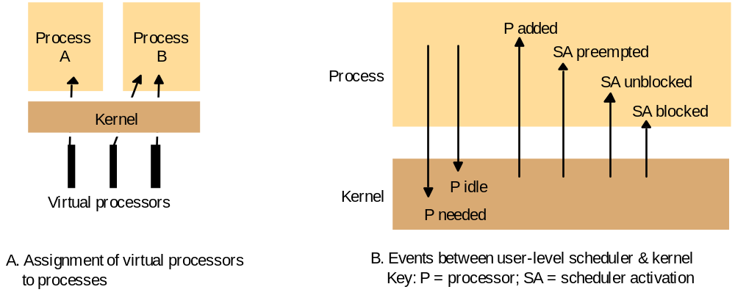
Scheduler activations
Figure 6.10
*
Notes:
Hidden

Slide 28
Support for communication and invocation
The performance of RPC and RMI mechanisms is critical for effective distributed systems.
  Typical times for 'null procedure call':
  Local procedure call < 1 microseconds
  Remote procedure call ~ 10 milliseconds
  'network time' (involving about 100 bytes transferred, at 100 megabits/sec.) accounts for only .01 millisecond; the remaining delays must be in OS and middleware - latency, not communication time.
Factors affecting RPC/RMI performance
  marshalling/unmarshalling + operation despatch at the server
  data copying:- application -> kernel space -> communication buffers
  thread scheduling and context switching:- including kernel entry
  protocol processing:- for each protocol layer
  network access delays:- connection setup, network latency
10,000 times slower!
*

Slide 29
Implementation of invocation mechanisms
Most invocation middleware (Corba, Java RMI, HTTP) is implemented over TCP
  For universal availability, unlimited message size and reliable transfer; see section 4.4 for further discussion of the reasons.
  Sun RPC (used in NFS) is implemented over both UDP and TCP and generally works faster over UDP
Research-based systems have implemented much more efficient invocation protocols, E.g.
  Firefly RPC (see www.cdk3.net/oss)
  Amoeba's doOperation, getRequest, sendReply primitives (www.cdk3.net/oss)
  LRPC [Bershad et. al. 1990], described on pp. 237-9)..
Concurrent and asynchronous invocations
  middleware or application doesn't block waiting for reply to each invocation
*

Slide 30
Invocations between address spaces
Figure 6.11
(a) System call
Thread
Control transfer via
trap instruction
Control transfer via
privileged instructions
User
Kernel
Protection domain
(b) RPC/RMI (within one computer)
boundary
Thread 1
Thread 2
User 1
Kernel
User 2
(c) RPC/RMI (between computers)
Thread 1
Network
Thread 2
User 1
User 2
Kernel 1
Kernel 2
*

Slide 31
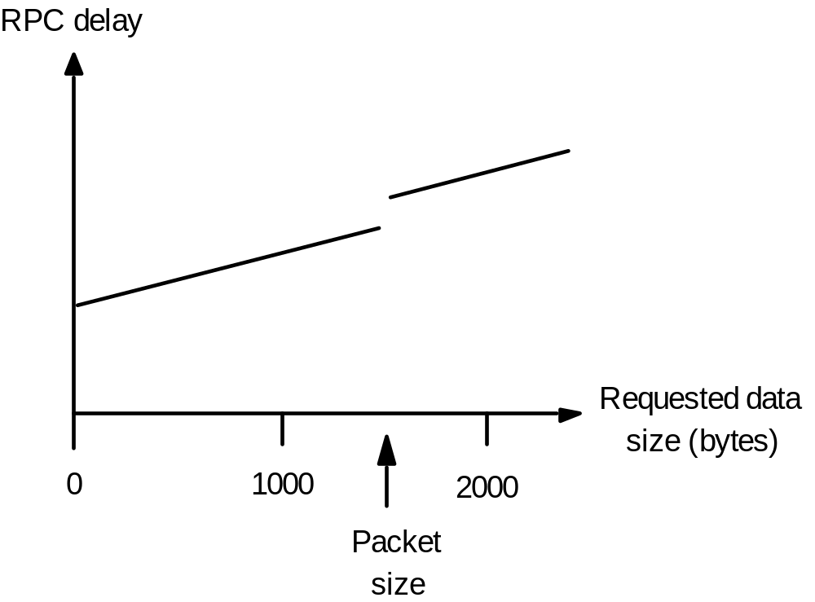
RPC delay against parameter size
Figure 6.12
*
Notes:
Hidden

Slide 32
Bershad's LRPC
Uses shared memory for interprocess communication
  while maintaining protection of the two processes
  arguments copied only once (versus four times for convenitional RPC)
Client threads can execute server code
  via protected entry points only (uses capabilities)
Up to 3 x faster for local invocations

Slide 33
A lightweight remote procedure call
Figure 6.13
Client
Server
A stack
A
1. Copy args
4. Execute procedure
and copy results
User
stub
stub
Kernel
2. Trap to Kernel
3. Upcall
5. Return (trap)
*
Notes:
Hidden - next slide is an animated version of this figure.

Slide 34
A lightweight remote procedure call
Figure 6.13
Client
Server
A stack
A
1. Copy args
4. Execute procedure and copy results
User
stub
stub
Kernel
2. Trap to Kernel
3. Upcall
5. Return (trap)
*

Slide 35
Times for serialized and concurrent invocations
Figure 6.14
Serialised invocations
Concurrent invocations
process args
process args
marshal
marshal
Send
transmission
Send
process args
marshal
Receive
Send
Receive
unmarshal
unmarshal
execute request
execute request
marshal
marshal
Send
Send
Receive
unmarshal
Receive
Receive
execute request
unmarshal
unmarshal
marshal
process results
process results
Send
process args
marshal
Receive
Send
unmarshal
process results
Receive
time
unmarshal
execute request
marshal
Send
Receive
unmarshal
process results
Client
Server
Client
Server
*
Notes:
Hidden

Slide 36
Monolithic kernel and microkernel
Figure 6.15
S4
.......
S1
S2
S3
S4
.......
S1
S2
S3
.......
Kernel
Kernel
Monolithic Kernel
Microkernel
Figure 6.16
Middleware
Language
Language
OS emulation
support
support
subsystem
subsystem
subsystem
....
Microkernel
Hardware
The microkernel supports middleware via subsystems
*

Slide 37
Advantages and disadvantages of microkernel
+ flexibility and extensibility
  • services can be added, modified and debugged
  • small kernel -> fewer bugs
  • protection of services and resources is still maintained
service invocation expensive
  • unless LRPC is used
  • extra system calls by services for access to protected resources

